Slide 1



Cloud Networking 101
Scott Taylor
Network Architect
Internet2
Networking to and inside the Cloud Service Providers
2024-12-09
ipv6tech
staylor@internet2.edu

Slide 2
Sample bulleted text:
• Welcome and TX24 At a Glance
• A Word From Attendees & Sponsors
• Event Details & Venue
• Speakers
• Thank You
Contents or
Agenda

Slide 3
Internet2 Cloud Connect (I2CC)

Slide 4

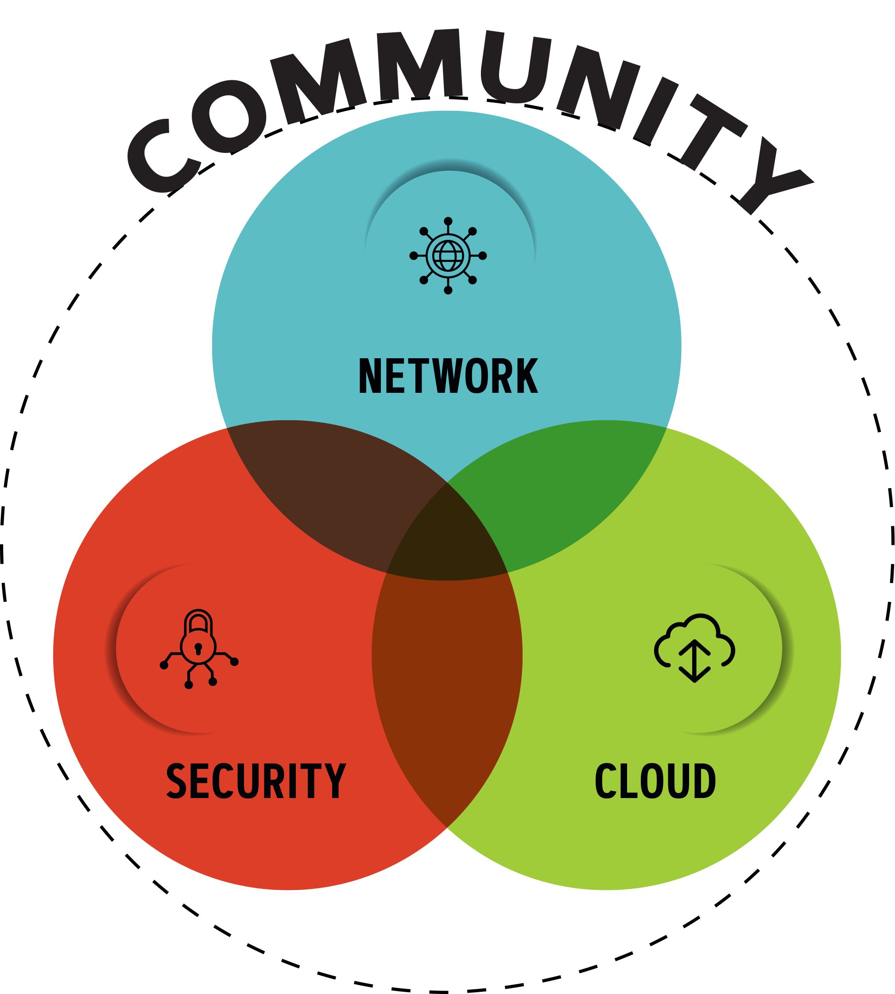
Internet2 Areas of Focus in Support of R&E
Internet2 is a community providing network, cloud and identity solutions, as well as research support and services tailored for R&E.
Our trusted, secure network empowers higher education, research institutions, government entities and cultural organizations.
4

Slide 5
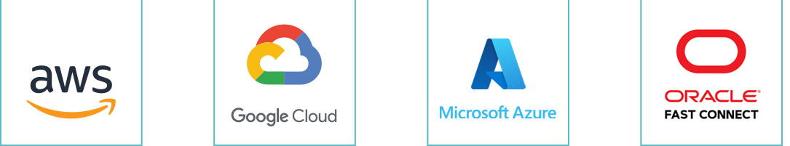
Getting to the Cloud
Internet2 Peer Exchange
I2PX
Use of the community’s existing 3Tbps of peering capabilities to the major cloud providers for access to cloud SaaS services (e.g., Zoom or Office 365)
Internet2 Cloud Connect
I2CC
Enables members to use the Internet2 and their regional’s infrastructure to obtain up to 5Gbps of “direct-connect” private Layer 2 and Layer 3 access to Amazon, Google, Microsoft, or Oracle cloud platforms at no additional fee. Extending your data center to the cloud. (Cloud provider fees apply)
Internet2 Rapid Private Interconnect
I2RPI
Provides private 10G interconnections at major peering points across the country at low annual rates. Leverages current investment in <regional network> and Internet2 infrastructures to reach cloud providers, for dedicated access or improved resiliency. May be used to connect to any commercial provider located at the peering point.

Slide 6
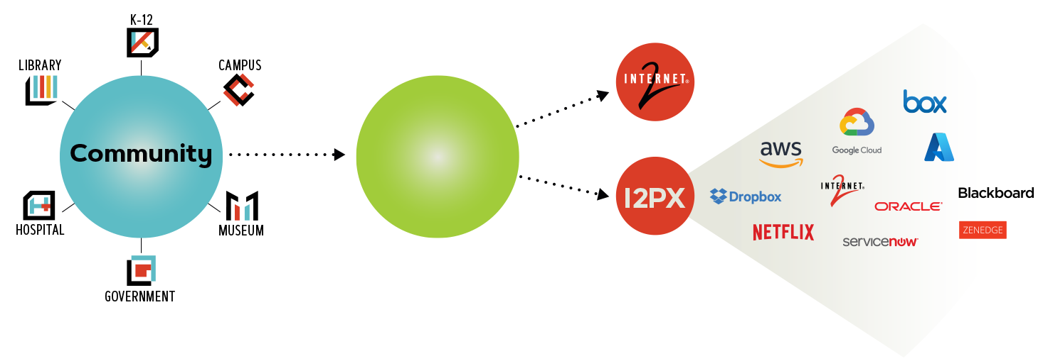


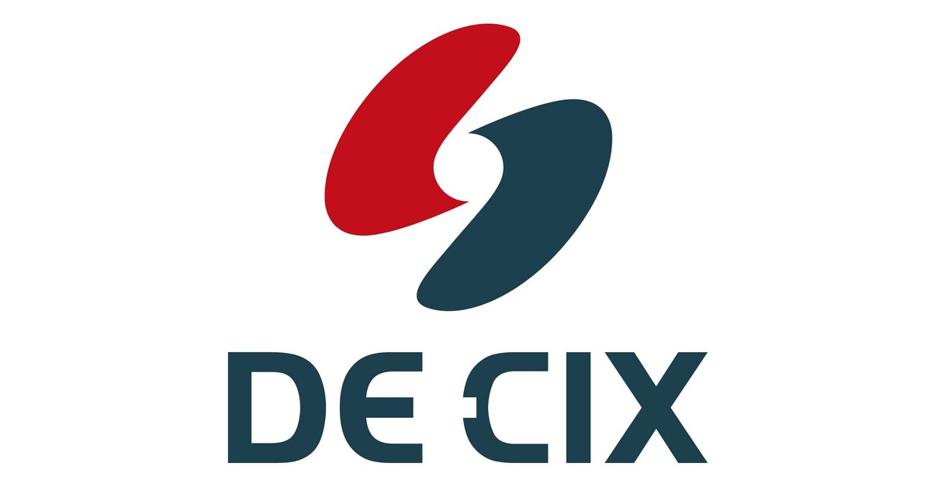

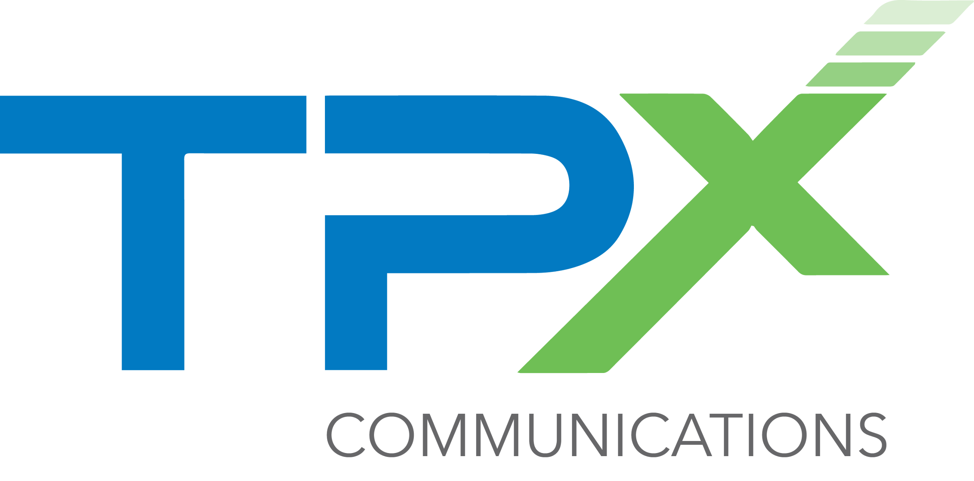


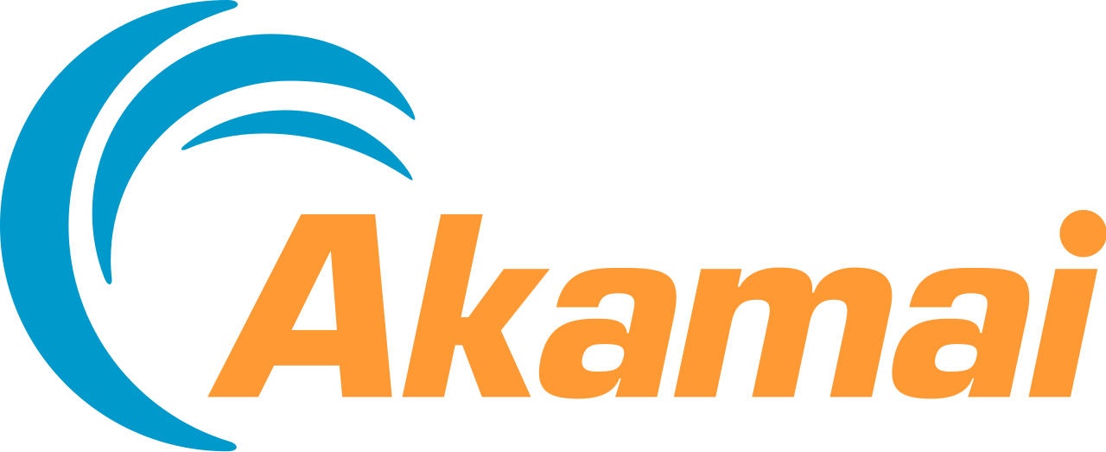


Designed from the ground up to meet the R&E Needs
Internet2 Peer Exchange
I2PX
REN
Allows REN to have high performing on-net access to cloud service providers, avoiding the commodity internet
Designed from the ground up to focus on hosting cloud providers most valued by the R&E community
Available to REN members today at no additional fee

Slide 7
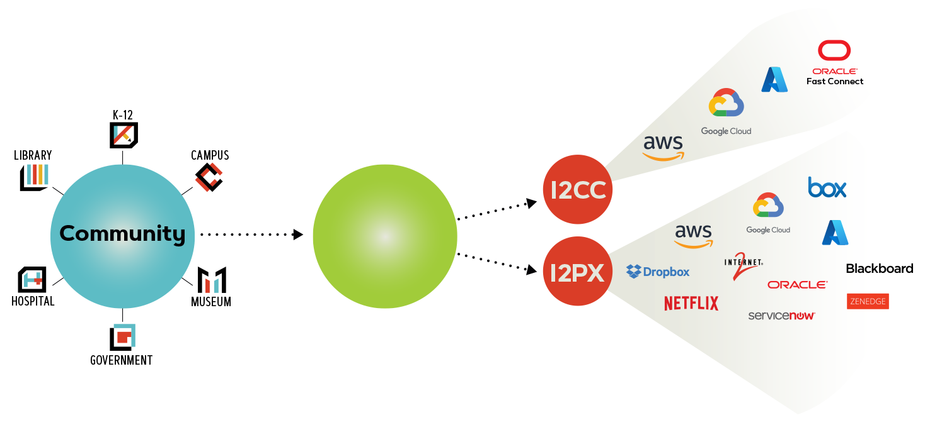
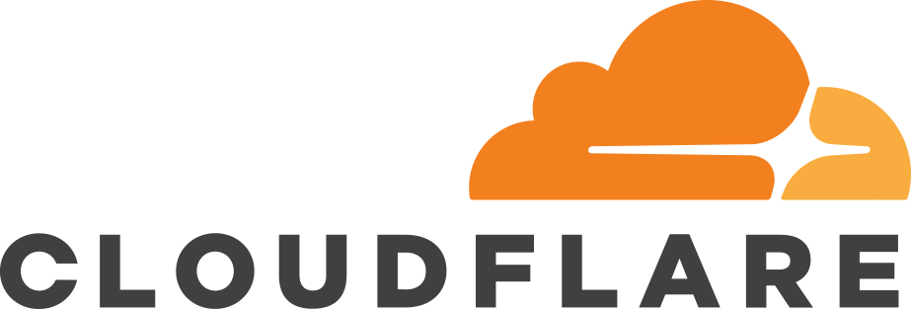

Leveraging R&E Networks for Direct Cloud Connections
Internet2 Cloud Connect
I2CC
REN
REN members can connect at Layer 2 or Layer 3
REN members can use Cloud Connect with up to 5Gbps connections to Amazon Direct Connect, Google Cloud Partner Interconnect, Microsoft Azure Express Route or Oracle FastConnect services
Available to REN members today at no additional fee

Slide 8
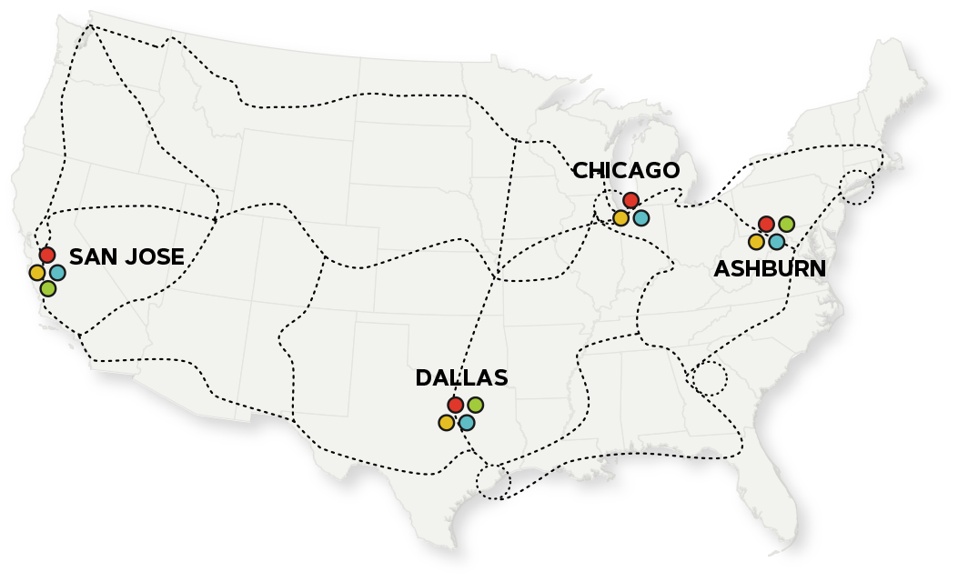




Nationwide Connectivity
Internet2 Cloud Connect
I2CC
Amazon Direct Connect
Google Cloud Interconnect
Microsoft ExpressRoute
Oracle Fast Connect
Notes:
Cloud Connect AWS

Slide 9
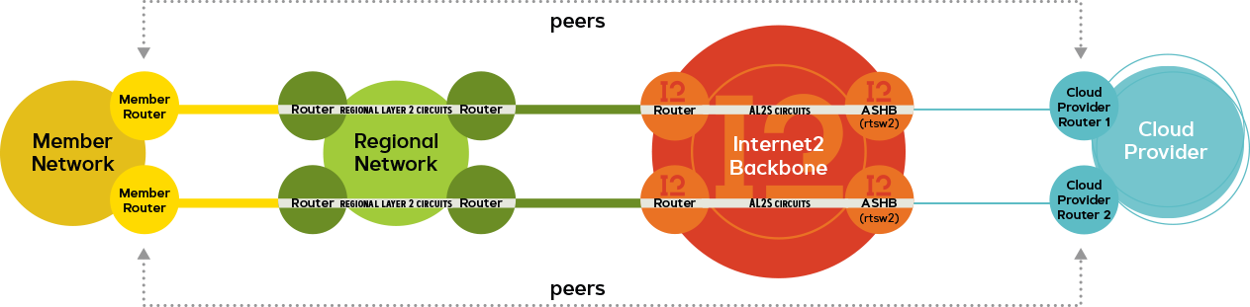
Layer 2 Connection Option
Internet2 Cloud Connect
I2CC
Notes:
Cloud Connect AWS

Slide 10
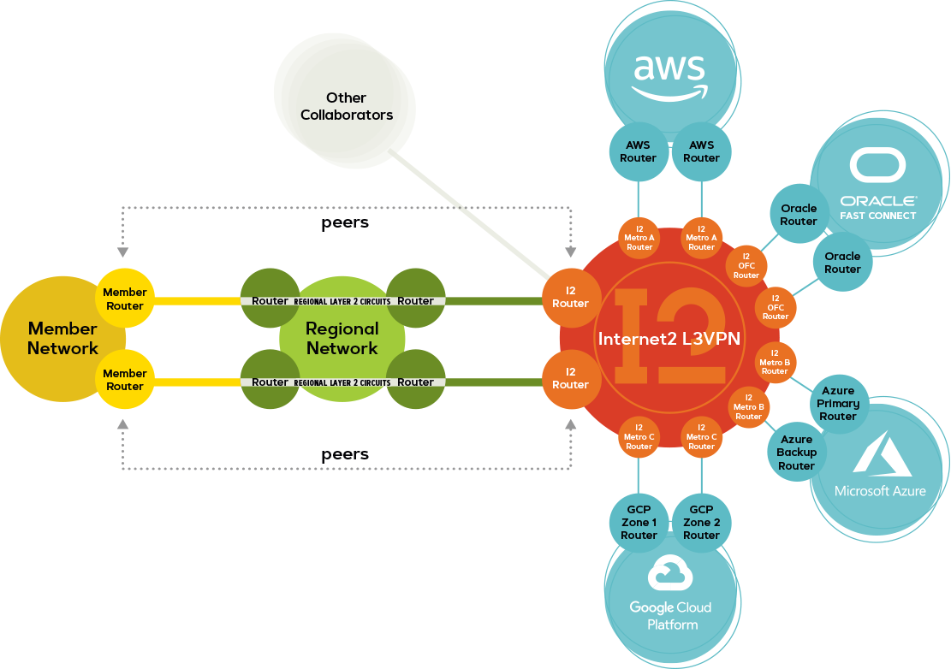
Layer 3 Connection Option
Internet2 Cloud Connect
I2CC
Notes:
Cloud Connect AWS

Slide 11
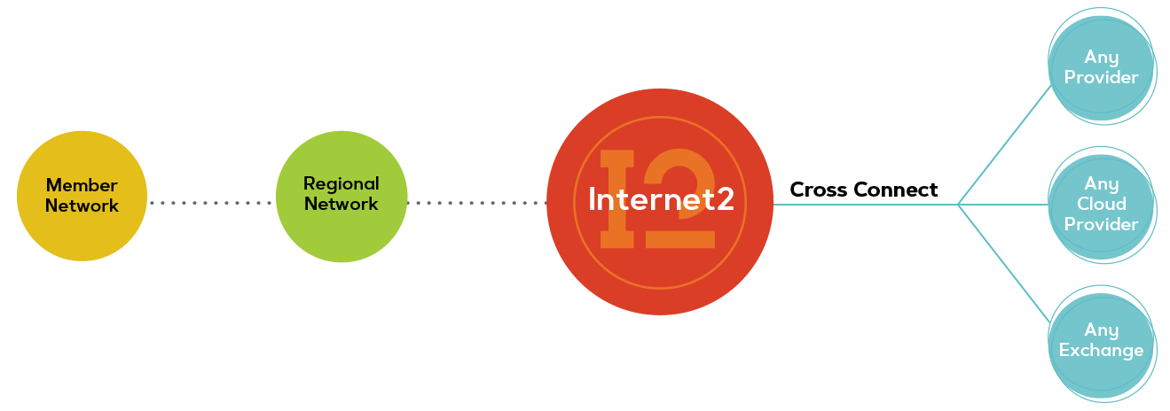
Flexible Connections to Any Provider
Internet2 Rapid Private Interconnect
I2RPI
Available through Network Connectors for an additional fee
Connect at Layer 2 or Layer 3
Private 10G dedicated connections to Amazon Direct Connect, Google Cloud Interconnect, Microsoft Azure ExpressRoute, or Oracle Fast Connect services
Private 10G dedicated connections to ANY service provider at major peering points
Notes:
Cloud Connect AWS

Slide 12
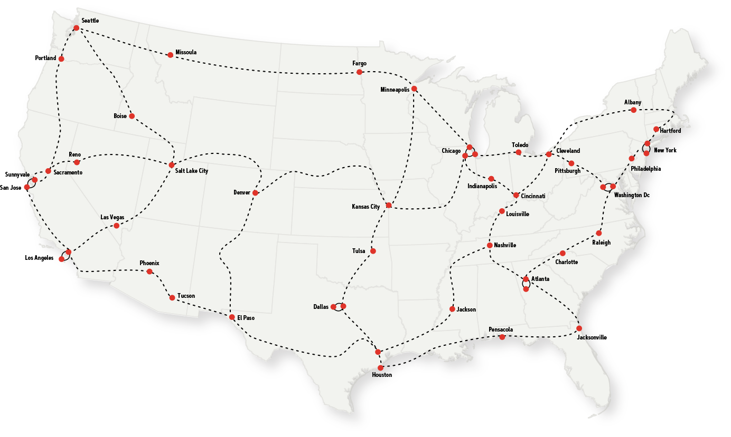
Nationwide Connectivity
Internet2 Rapid Private Interconnect
I2RPI
can be used to provide private direct connects to any provider with some examples being 10G connections to SIP service providers, esports exchanges or other cloud providers.
Notes:
Cloud Connect AWS

Slide 13
Hybrid and Multicloud

Slide 14
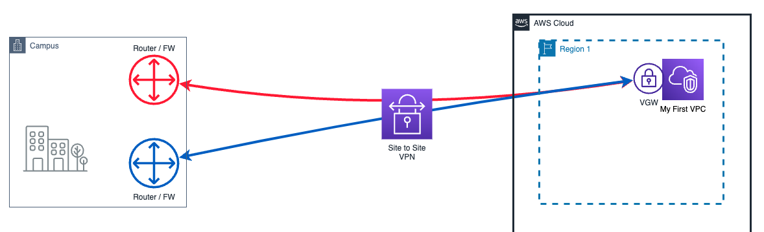
Hybrid Cloud

Slide 15
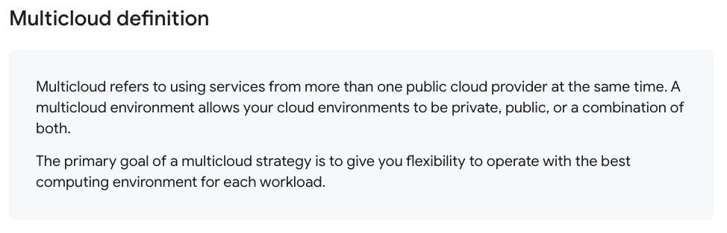
Multicloud

Slide 16
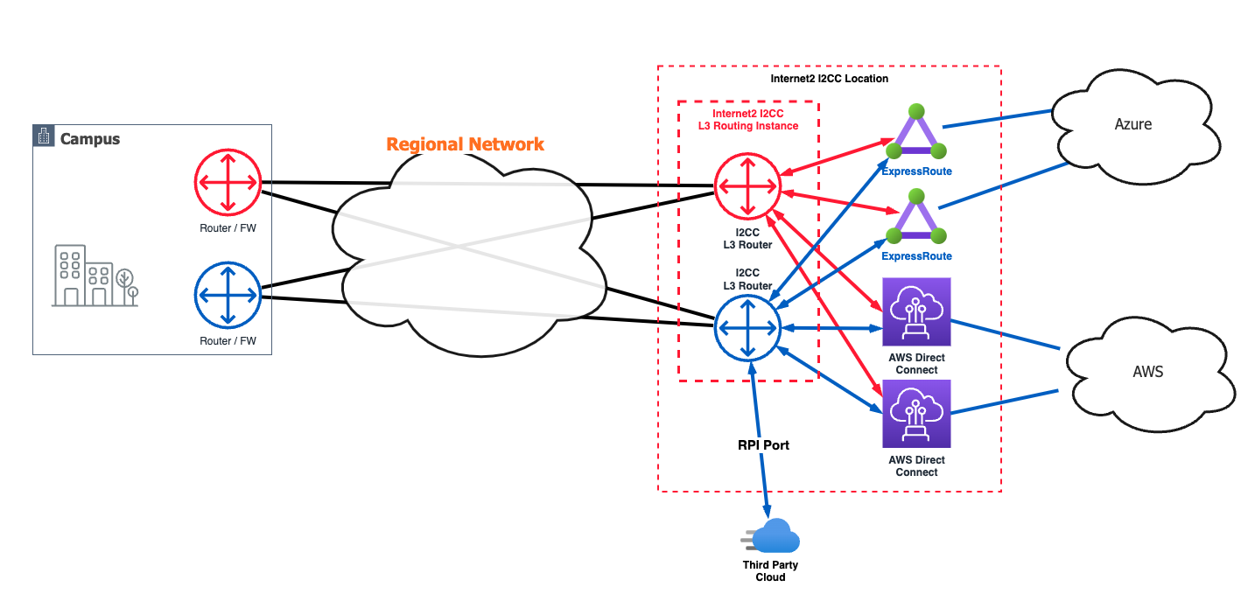
Multicloud

Slide 17
How, why, and when to use I2CC

Slide 18

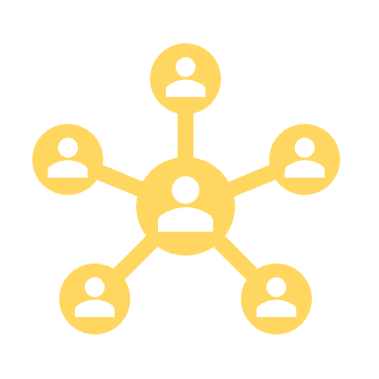


WHY, HOW, AND WHEN TO USE I2CC
Boost Network Performance
Architect for Resiliency
Simplify Connectivity
Better Supportability
Reduce Cost
Notes:
Boost network performance
Architect for redundancy
Improve reliability
Reduce cost

Slide 19
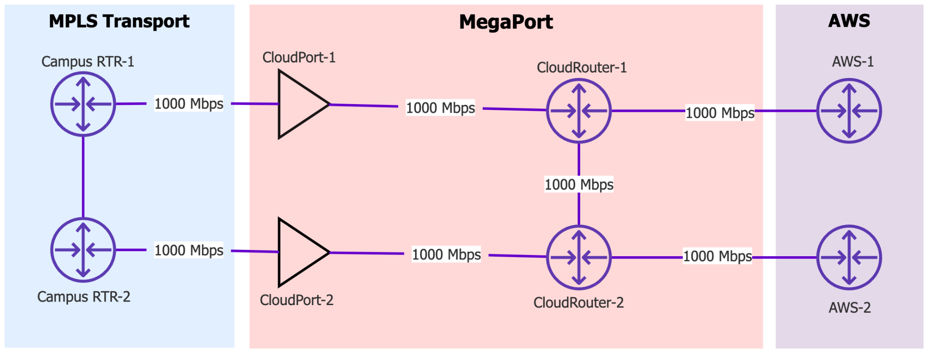
LET’S TALK COST
Notes:
Let’s talk cost for a second.

Slide 20
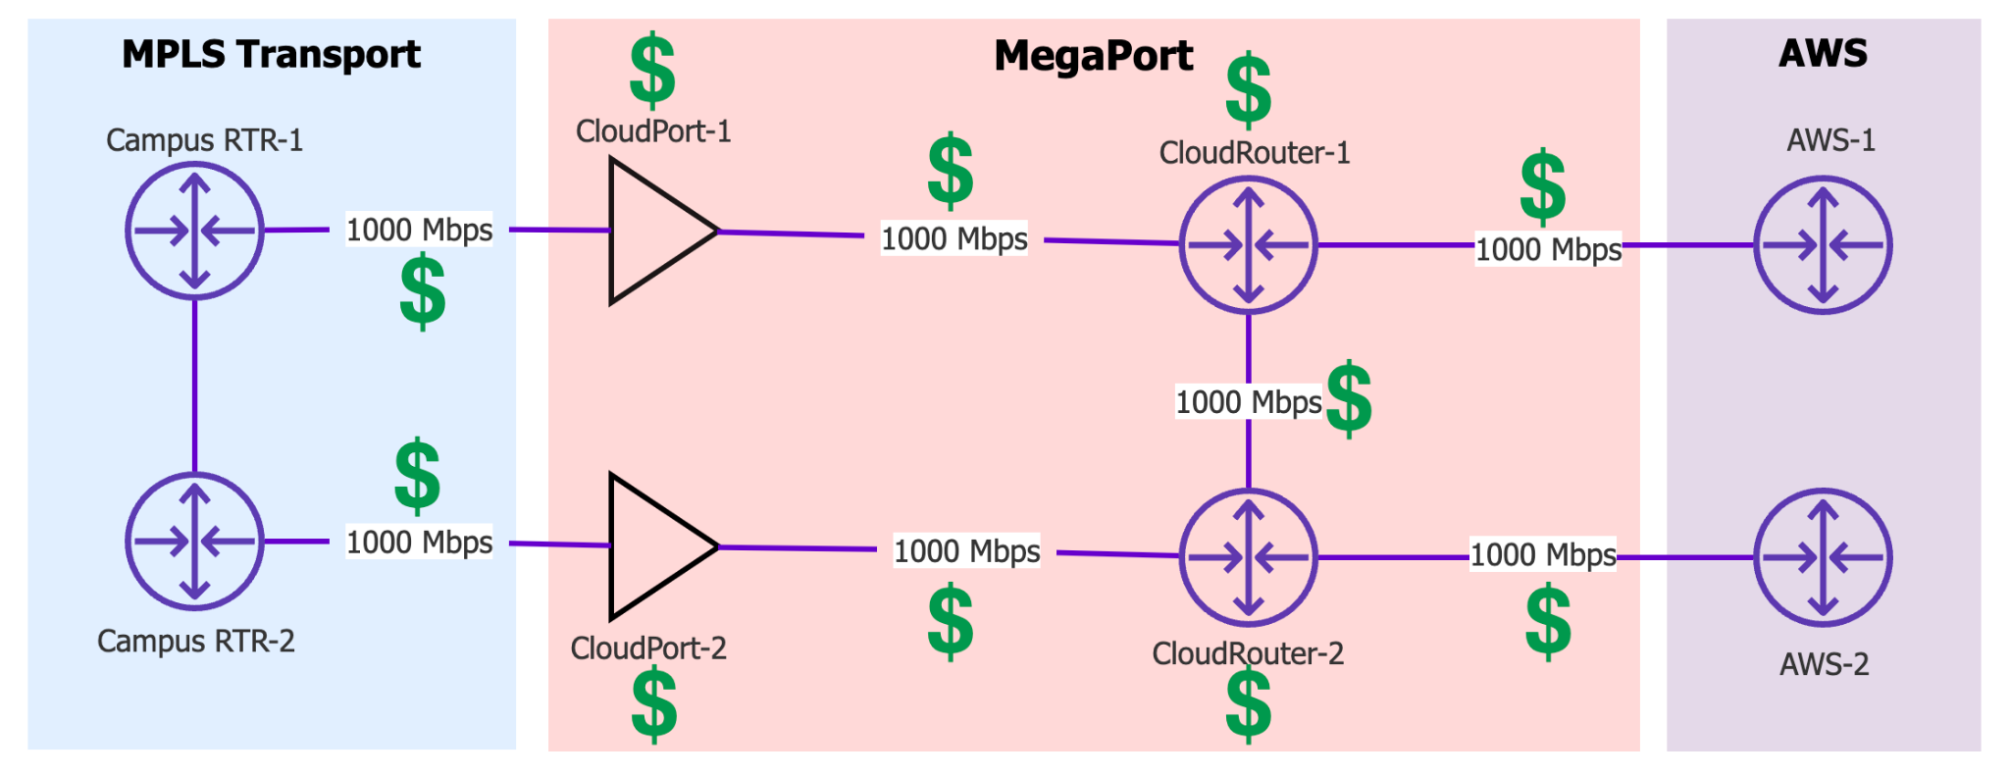
MEGAPORT EXAMPLE
Notes:
Performance
Simplification
Cost Savings with Internet2
Are you doing this?! VPN between cloud providers…
How about this?! hairpin traffic back to Campus
Or this?!! VPN Hell!
Or worse VPN to every VPC + Cloud?!
How about

Slide 21
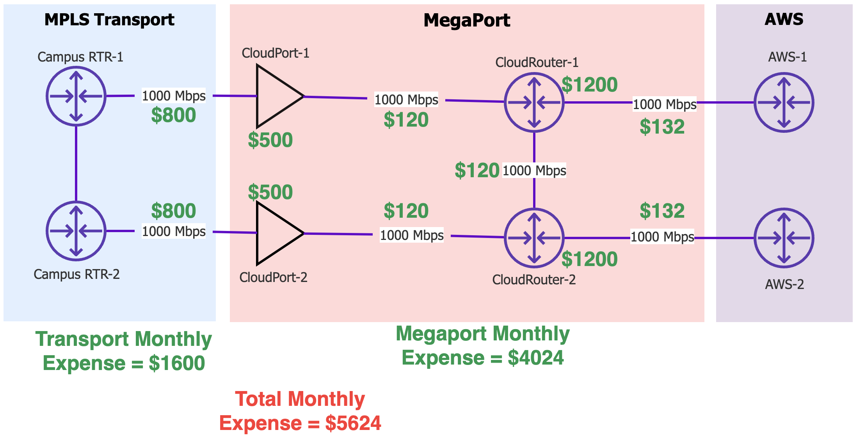
MONTHLY EXPENSE EXAMPLE

Slide 22
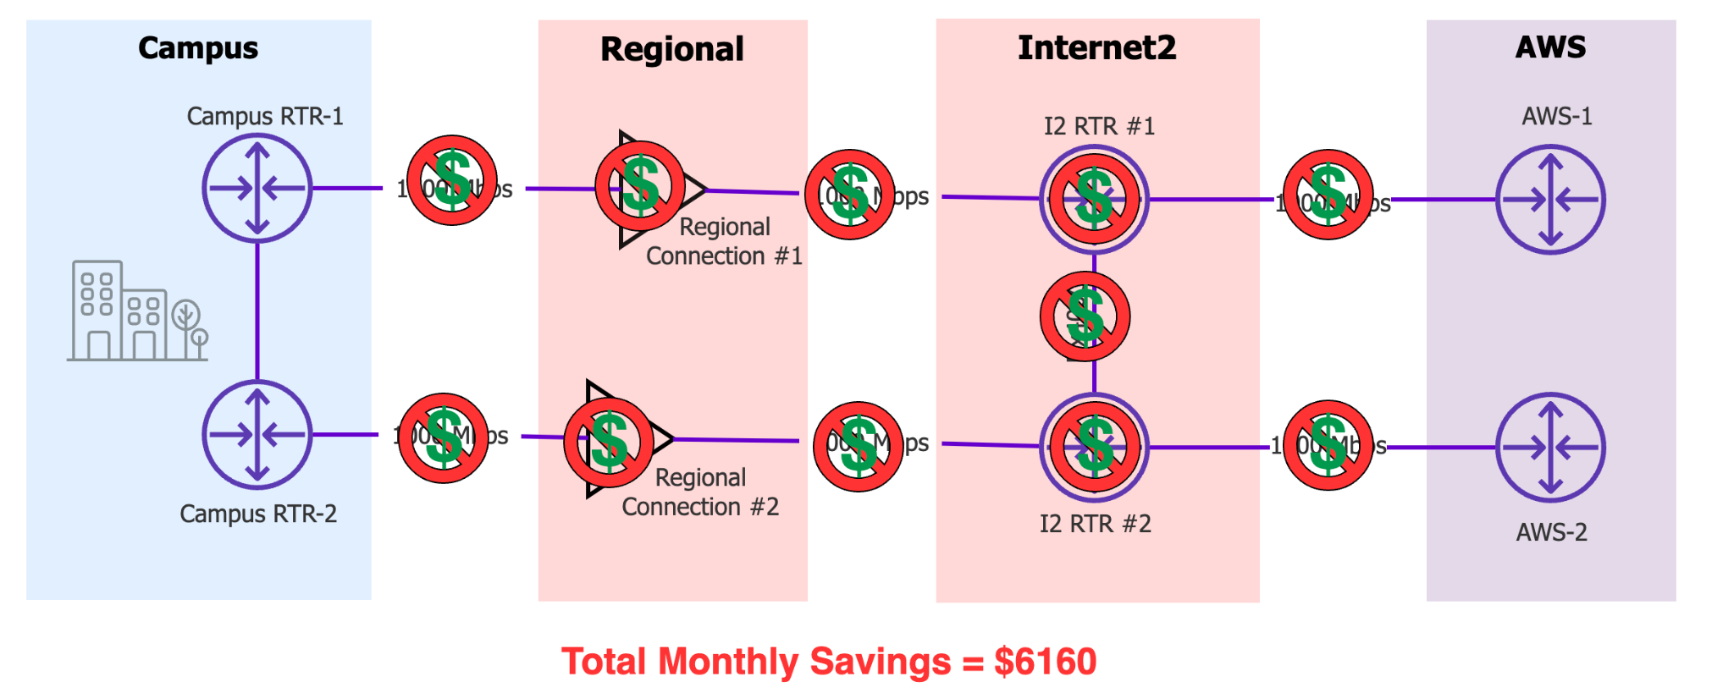
I2CC MONTHLY SAVINGS
Total monthly saving: $5,624

Slide 23
Large Platform Flex

Slide 24
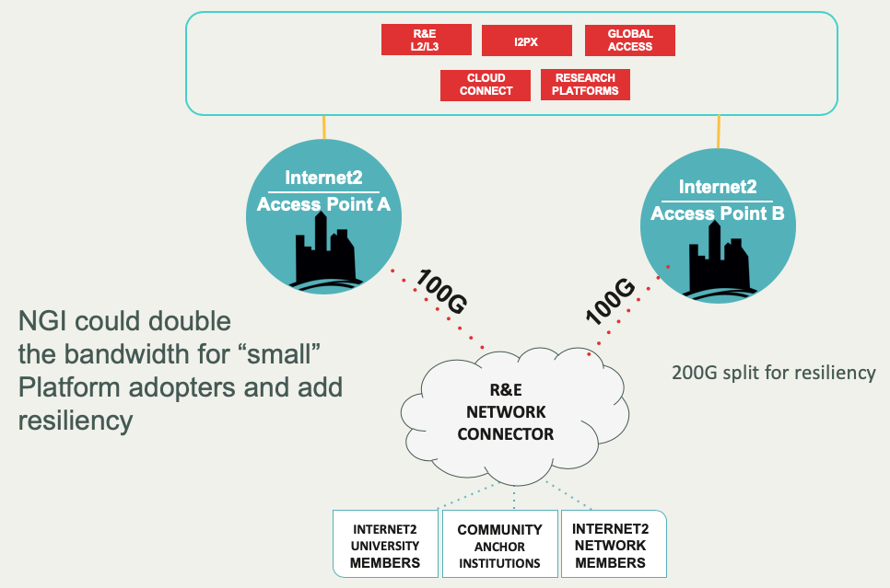
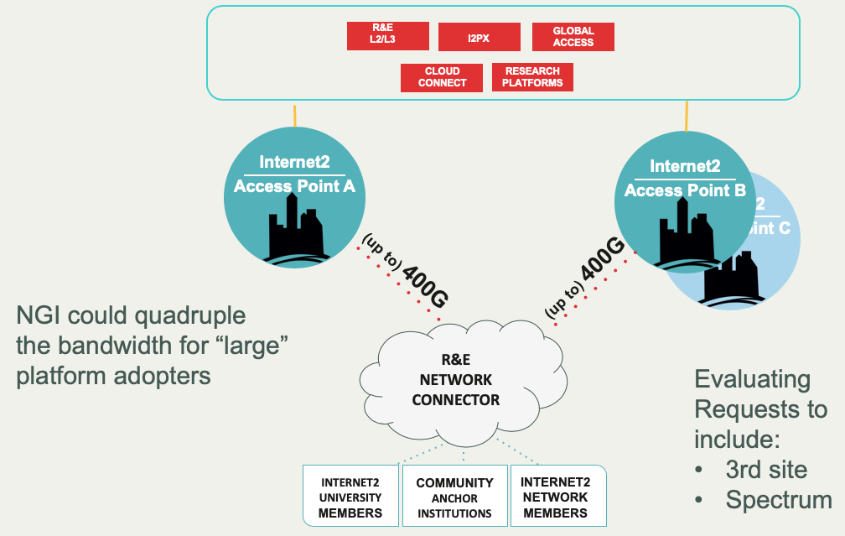
Current Platform Model
NGI Small
NGI Large
(Research Intensive)

Slide 25
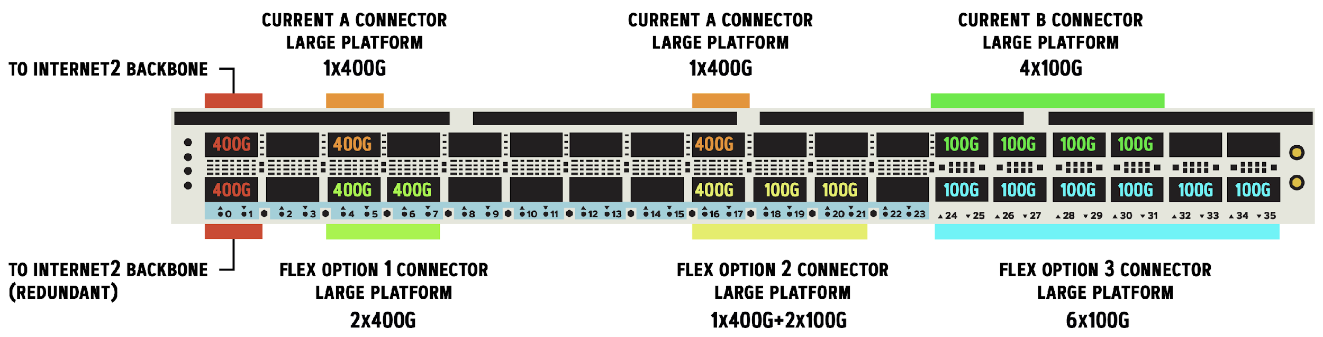
Large Platform Flex

Slide 26
Internet2 Insight Console
Overview

Slide 27
Internet2 Insight Console
Sections covered
Community – Organize child organizations and add users
Interfaces – View interfaces or VLANs and delegate VLANs to other Orgs
Virtual Networks – Configure new connections/services
Looking Glass – Troubleshoot

Slide 28
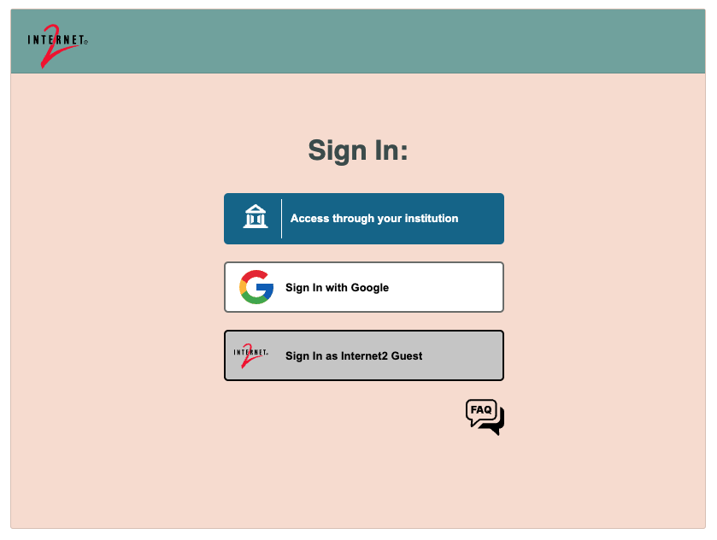
Internet2 Insight Console
Access through your institution is the preferred method.
If your institution uses InCommon you’ll likely have the ability to sign in.
You might need Internet2 to create or move your institution into the correct hierarchical tree structure.

Slide 29
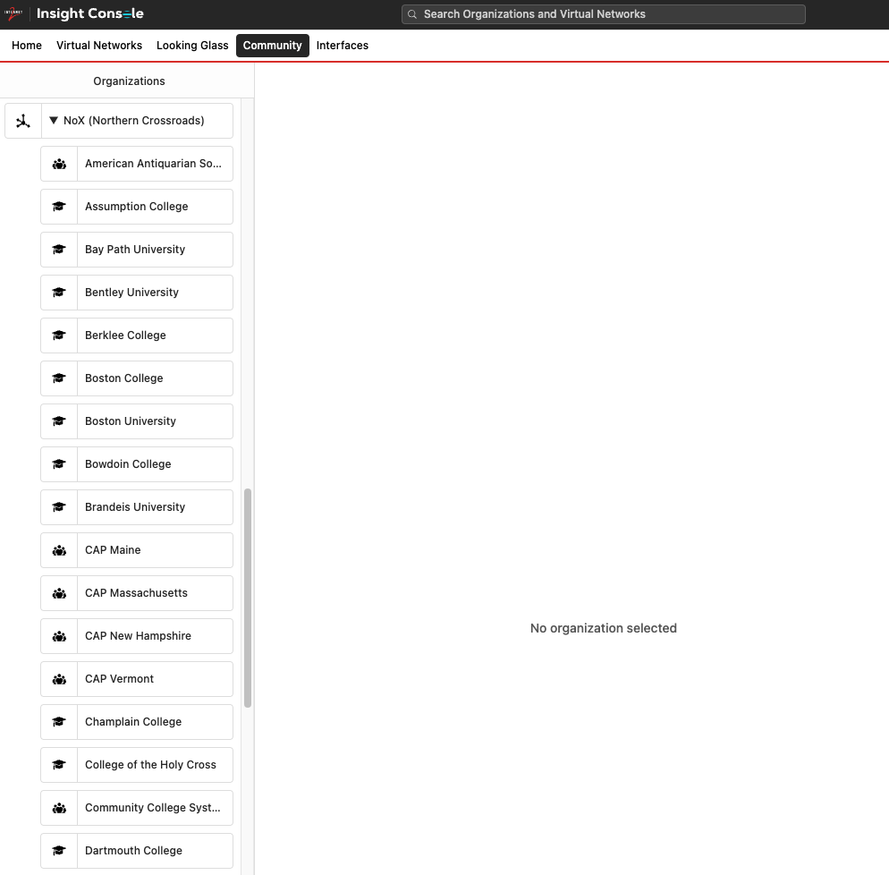
Community
Organize child organizations and add users

Slide 30
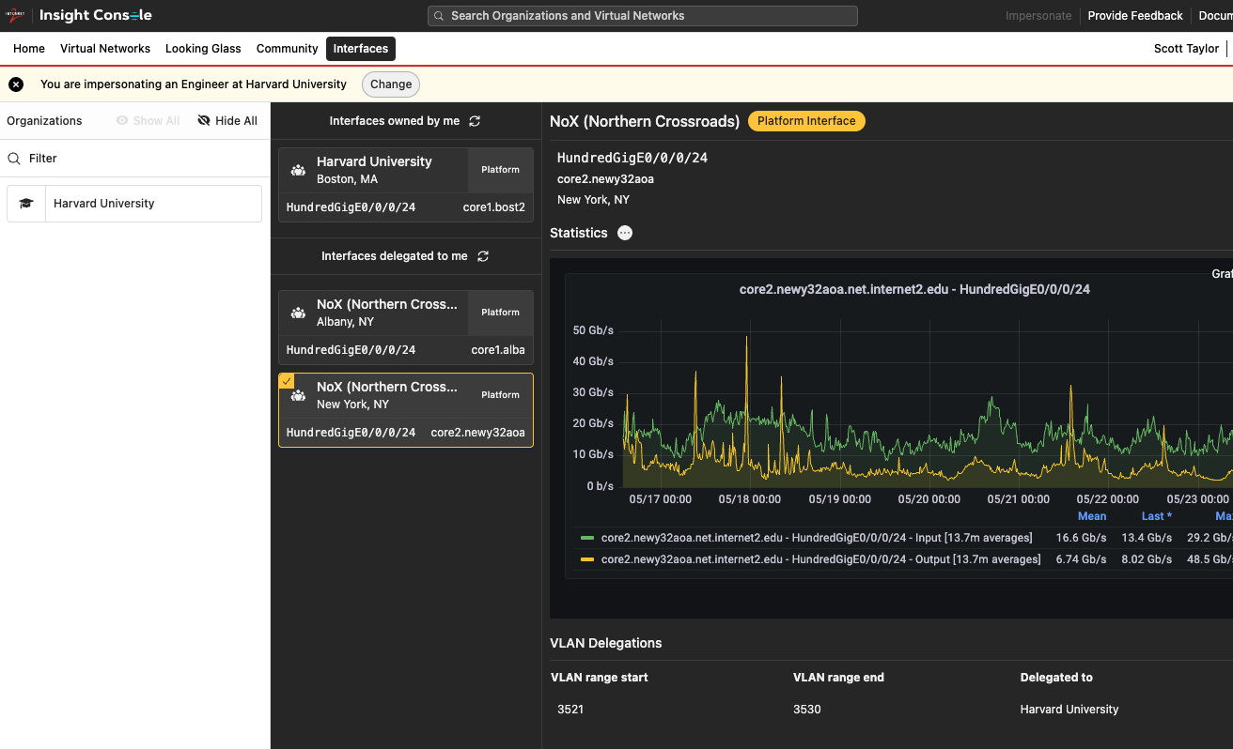
Interfaces
View interfaces or VLANs and delegate VLANs to other organizations

Slide 31
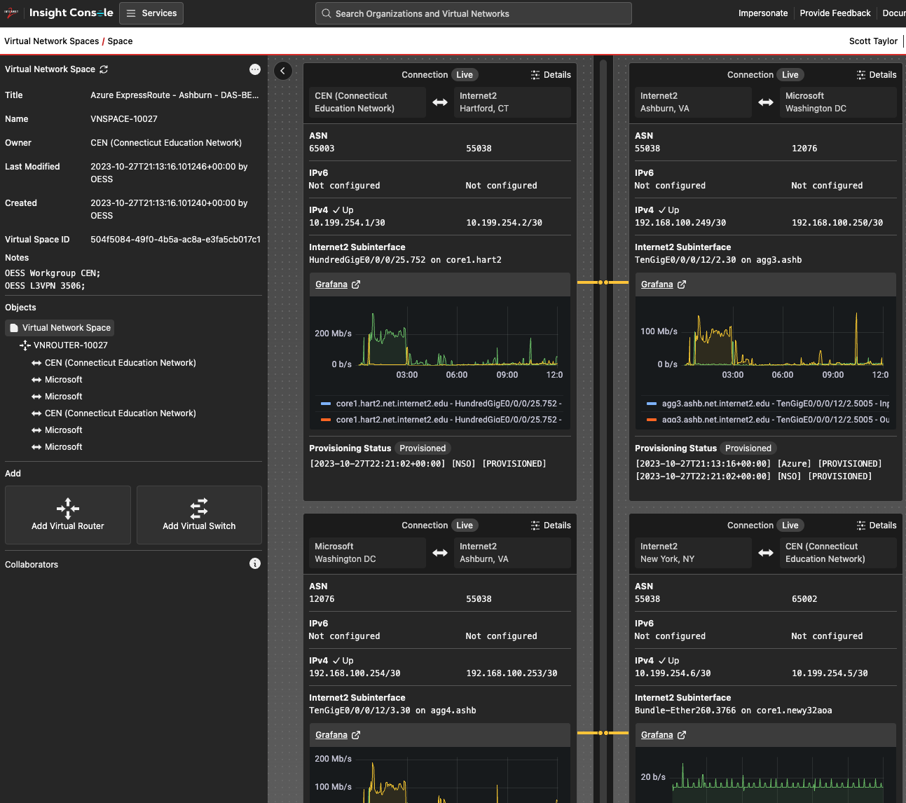
Virtual Networks

Slide 32
Cloud Networking Overview

Slide 33
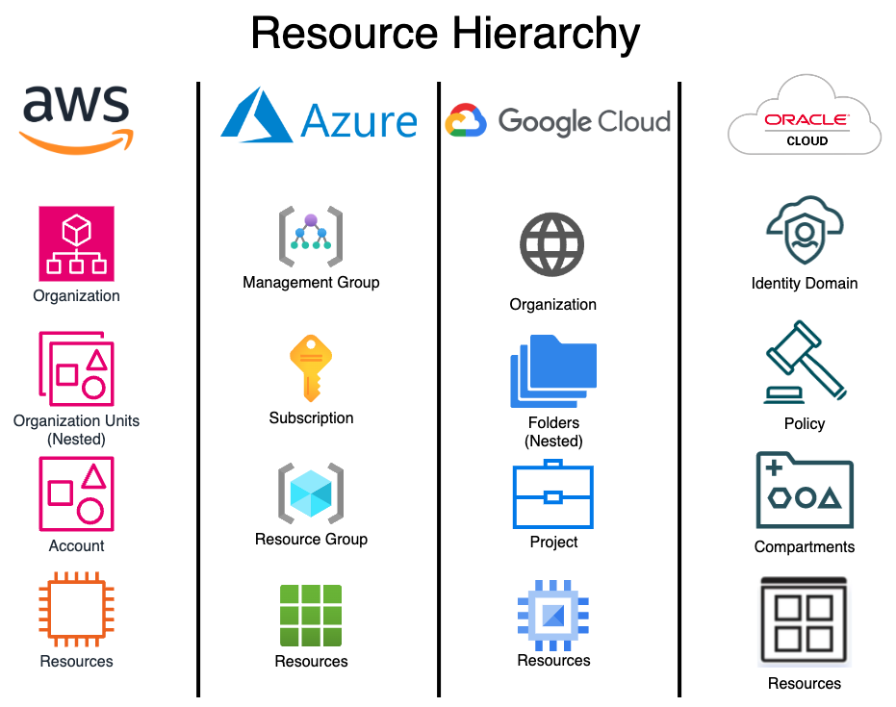
CSP Resource Hierarchy

Slide 34
Resources: Global, Regional, Zone
This is an important distinction to understand and to understand which services fall into which classification and what their failure domains are so you can build resilient “well-architected” services. Additionally, you need to consider the performance and cost ramifications of each decision. We won’t go too deep into this area but it’s important to understand the high-level concepts so when we talk about where services fit in you understand them a bit more.
Lots of resources (think services)
Global resources are resources that are accessible globally, from anywhere.
Regional resources would be restricted to a geographic region
Virtualized services supported across multiple sites
Zone-based resources are typically tied to a single site or group of sites in a metro area.
A physical (dedicated) connection, server, etc can’t be in two places at the same time
Availability Zone
which typically fall into either Global, Regional or Zonal resource areas.
Global means available in across the CSP’s whole network
Regional would be what it sounds

Slide 35
Regions and Zone comparison
Each CSP has a concept of a virtual Data Center

Slide 36
Failure Domains
Important to understand the differences between providers and how to network architect inside a provider to avoid failure.
Each provider is slightly different with their terminology and how their virtual network / data centers operate from a failure perspective.

Slide 37
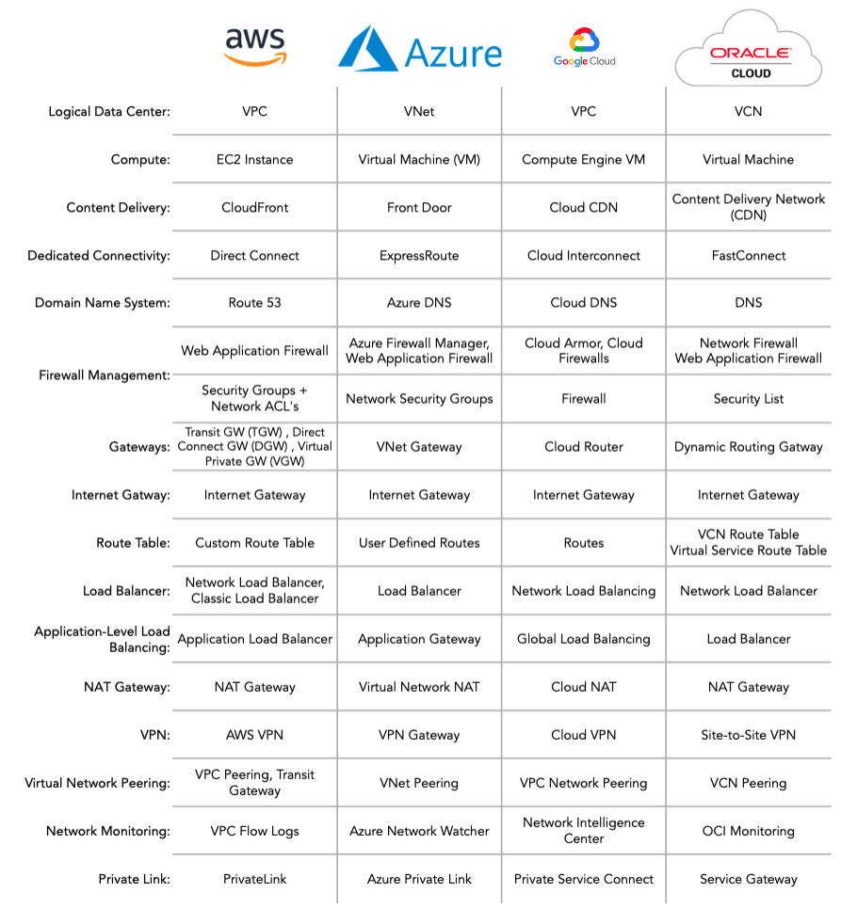
CSP Networking “Rosetta stone”

Slide 38

Cont…

Slide 39
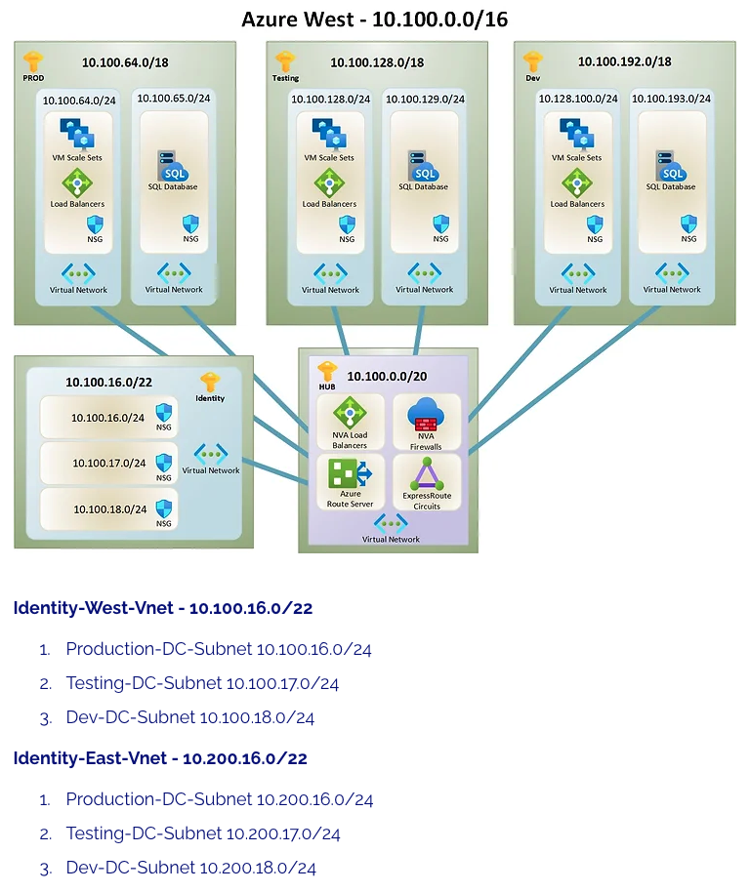
IP Address Planning
Plan for expansion
Reserve space to grow
Plan for multiple regions
Plan for multiple Clouds
Do NOT overlap addressing!
Plan for future cloud architectures
Don’t forget to plan for IPv6!

Slide 40
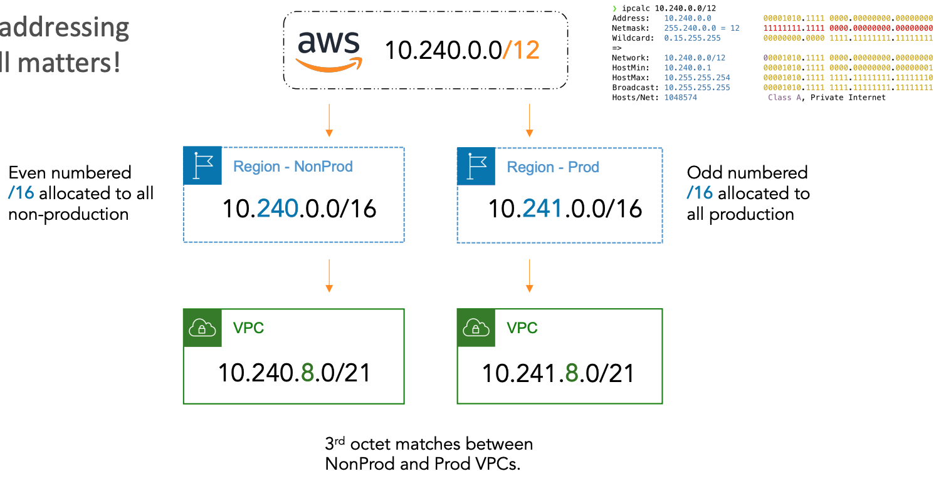
IP Address Plan Example

Slide 41
Cloud Network – Key Elements

Slide 42
Virtual Data Center
Each CSP has a concept of a virtual data center
In AWS this is a VPC or Virtual Private Cloud
In Azure this is called a VNET or Virtual Network
In Google this is called a VPC or Virtual Private Cloud
In Oracle this is referred to as a VCN or Virtual Cloud Network

Slide 43
Key Differences
Subnets
AWS – tied to a single AZ
Azure – span AZ’s but tied to a region
Azure recently announced a public preview for “private subnets”
Their default has been to allow outbound internet traffic for resources in a subnet.
Google – VPC’s and Subnets are a global resource
VPC isn’t tied to a specific region
When the global network is created default subnets are created in each region.
By default all VM’s in a VPC can communicate with each other
Oracle – A

Slide 44
Key Differences
Resources
AWS – within a region can communicate
Azure
Resources required to be within a region as the VNET in order to be placed into a subnet.
By default resources within a VNET can communicate with other resources including resources in different subnets.
Internet access by default
Google – VPC’s and Subnets are a global resource
Oracle – A

Slide 45
Service Types
Public vs Private services
Public services are services that are reachable via the public Internet.
Private services are services that require additional configuration to be accessible.
Public services are services like Azure Blob Storage, AWS S3, Google CDN, AWS Bedrock, OCI Public DNS
Private services are services like AWS EC2, Oracle Private DNS, Azure VNET, Google VPC

Slide 46
Connectivity Options
Public Services connectivity options
ISP Connectivity – for services reachable over the public internet
Internet2 Peering Exchange (I2PX)
Private Services connectivity options
IPsec tunnels (VPN)
Private Connectivity
- Dedicated vs Hosted

Slide 47
AWS Direct Connect
Private peering: Accepts up to 100 prefixes each for IPv4 and IPv6
Public peering: Accepts up to 1000 prefixes
BGP state goes to idle (BGP peering goes down)
Azure ExpressRoute
Private peering: Accepts up to 4000 prefixes ^{[1]}
Public peering: Accepts up to 200 prefixes
BGP session is dropped
Oracle FastConnect
Public peering: Accepts up to 200 prefixes
Private peering: Accepts up to 2000 prefixes
BGP session brought down ^{[2]}
Google Cloud Interconnect (Cloud Router)
No published limits on Interconnect; limits exist on Cloud Router ^{[3]}
An important number to keep in mind is 250 prefixes
BGP doesn’t go down instead uses deterministic route-dropping behavior

Slide 48


Most common causes:
Poor planning
Accidental routing change
Route creep over time (maybe not completely poor planning)
New subnets/connections
Workarounds

Slide 49
Load Balancers

Slide 50
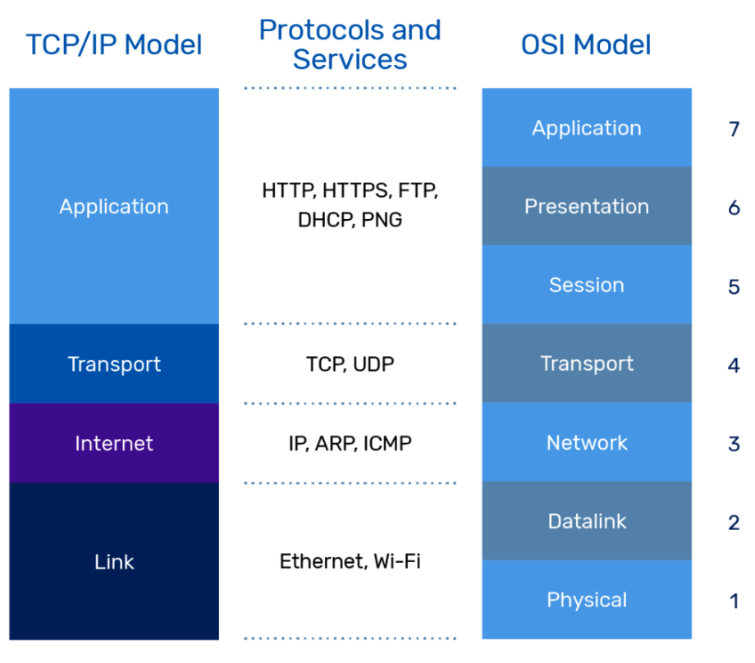
Network Communication Models

Slide 51
AWS Components

Slide 52
AWS Direct Connect
Hosted Direct Connect
Connections go through a partner (e.g., Internet2)
Can range from 50 Mbps to 5 Gbps or more
Quick to provision (< 10 minutes)
Dedicated
Ethernet port “dedicated” to a single AWS customer
Connection established directly to AWS
Possible to use Internet2 RPI to connect to AWS
Interface speeds supported 10 Gbps, 100 Gbps
Can support MACsec

Slide 53
Azure Components

Slide 54
Azure ExpressRoute
ExpressRoute
Connections go through a partner (e.g., Internet2)
Can range from 50 Mbps to 5 Gbps or more
Quick to provision (< 10 minutes)
ExpressRoute Direct (Dedicated)
An institution is the only user of a Dedicated Connection
Connection established directly to AWS
Possible to use Internet2 RPI to connect to AWS
Interface speeds supported 10 Gbps, 100 Gbps
Can support MACsec

Slide 55
Google Cloud Components

Slide 56
Google Partner Interconnect
Partner Interconnect
Connections go through a partner (e.g., Internet2)
Can range from 50 Mbps to 5 Gbps or more
Quick to provision (< 10 minutes)
Interconnect (Dedicated)
An institution is the only user of a Dedicated Connection
Connection established directly to AWS
Possible to use Internet2 RPI to connect to AWS
Interface speeds supported 10 Gbps, 100 Gbps
Can support MACsec

Slide 57
Oracle Cloud Components

Slide 58
Oracle FastConnect
FastConnect (Partner)
Connections go through a partner (e.g., Internet2)
Can range from 1 Gbps to 5 Gbps or more
Quick to provision (< 10 minutes)
FastConnect (Dedicated)
An institution is the only user of a Dedicated Connection
Connection established directly to AWS
Possible to use Internet2 RPI to connect to AWS
Interface speeds supported 10 Gbps, 100 Gbps
Can support MACsec

